Slide 1
Visual Cryptography
Group 9

Slide 2
Outline
Intro
Motivation
Visual Cryptography Schemes for Black and White images
(K, N) secret sharing technique
(2, 2) secret sharing technique
(N, N) secret sharing technique
Image encryption using keys
Applications of Visual Cryptography
Biometric Authentication
Digital Image Copyright protection
Conclusion

Slide 3

Introduction
Visual Cryptography is a technique that allows visual information to be encrypted in such a way that the decrypted information appears as a visual image

Slide 4
Visual Cryptography Schemes

Slide 5
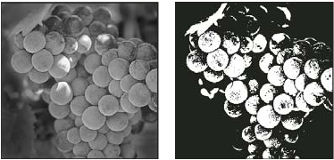
… for black and white images
Greyscale
Black and White
Notes:
Can be used for:
-> Blueprints
-> Symbols / Logos
-> Document type images
-> Diagrams

Slide 6
(K, N) secret sharing scheme
Shamir’s secret sharing scheme:
A secret S is split into N unique parts called “shares”
Two basic rules are followed:
The complete secret S can be reconstructed from any K out of the N different shares
Knowledge of (K - 1) shares of the secret (or less) provides no indication towards S and leaves the secret completely undetermined

Slide 7


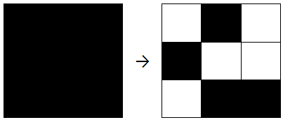
(2, 2) secret sharing technique
Each pixel of original secret is looked at and worked upon individually
The pixel is broken up into different sub pixels and coloured based on the original colour
There are different ways of splitting up a pixel:
Into x = 2 subpixels: (aspect ratio changes)
Into x = 4 subpixels:
Into x = 9 subpixels:
...etc.

Slide 8
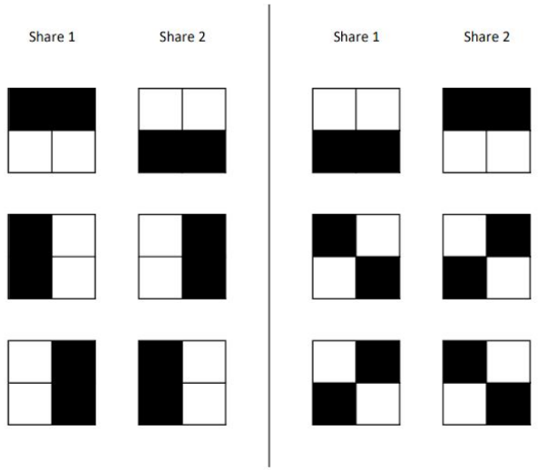
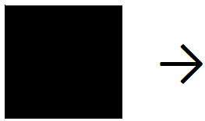
(2, 2) secret sharing technique - splitting
Black pixel:
(4 subpixel case)

Slide 9
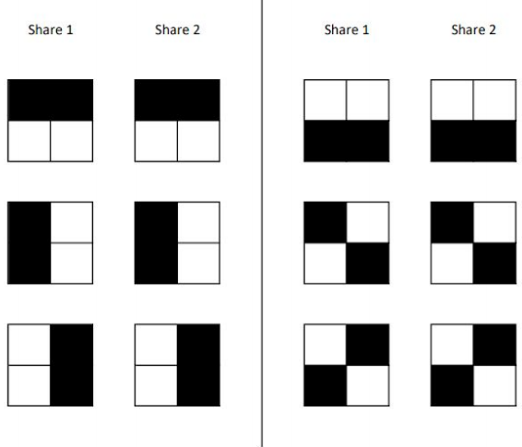
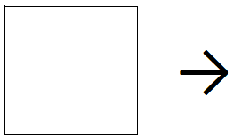
(2, 2) secret sharing technique - splitting
White pixel:
(4 subpixel case)

Slide 10
(2, 2) secret sharing technique - combining
To combine the two shares, we overlap the two shares (considering a white pixel to be transparent)
This operation is equal to the logical OR operator where a white pixel is considered 0 and a black pixel is considered 1
Therefore
White + White = White
White + Black = Black
Black + White = Black
Black + Black = Black
This is a probabilistic technique
Security provided is 2^{xLW/2} (if Oscar has one share)
(where x is the number of subpixels per pixel)

Slide 11
(N, N) secret sharing technique
N shares are created out of which all are required to reproduce the secret
The pixel can be split up into multiple subpixels just like before (to increase security)
To keep things simple, we will not split the pixel into subpixels during the explanation

Slide 12
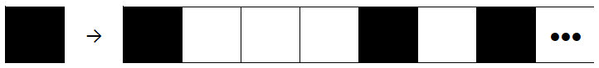
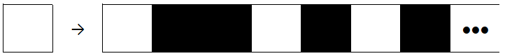
(N, N) secret sharing technique - splitting
Black pixel:
Choose a number P ∈ {0, 1 … N} such that P is odd
Create a set [1, 0, 0, 0, 1 … ] of N elements which contains P 1s (randomly placed using TRNG)
Assign white if the corresponding share is 0 and black if the corresponding share is 1
White pixel:
Choose a number P ∈ {0, 1 … N} such that P is even
Create a set [0, 1, 1, 0, 1 … ] of N elements which contains P 1s (randomly placed using TRNG)
Assign white if the corresponding share is 0 and black if the corresponding share is 1

Slide 13
(N, N) secret sharing technique - combining
The shares are combined using the XOR operator on each pixel
Therefore
White + White = White
White + Black = Black
Black + White = Black
Black + Black = White
This is a probabilistic technique
Security provided is 2^{xLW} (if Oscar has t shares, where 1 <= t < N)
Security is exponentially greater than the previous technique

Slide 14
Issues with K < N
The issues which are commonly faced when K is selected such that it is less than N are:
Because of the necessity of ensuring that (K - 1) and lesser shares should not combine to give any clue whatsoever towards the original secret, many times there is a loss of generality when selecting any K shares out of the N choices i.e. only specific sets of K shares out of the N choices actually reproduce the original secret
To enable reconstruction of the secret using only K shares, the interrelationships between the subpixels becomes important. As a result, the time taken to split and combine the shares increases substantially
Susceptible to distortion and data loss

Slide 15




Implementation of (2, 2) secret sharing tech..
Share 1
Share 1
+
Share 2
Share 1

Slide 16







Implementation of (N, N) secret sharing
N = 3
Share 1
Share 1 + 2
Secret
Share 2
Share 2 + 3
Share 1 + 2 + 3
Share 3
Share 3 + 1

Slide 17
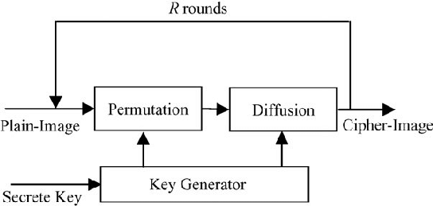
Image Encryption using Keys
Confusion:
Permutation of the pixel positions in the image
Diffusion:
Changing the pixels’ grayscale values

Slide 18
Chaotic Maps
A chaotic system is a deterministic system that exhibits seemingly random behaviour due to its sensitive dependence on initial conditions.
Images are encrypted using a sequence of numbers generated by a chaotic map
We use chaotic maps in cryptography by:
Generating a pseudo-random key stream by using the chaotic map
Using the control parameter as secret keys

Slide 19

Logistic Map
The logistic map is characterized by the equation:
Where r and x₀ are control parameters and x₀ is a number between zero and one

Slide 20
Behaviour of the Logistic Map
When r is between 0 and 1: x_{n} eventually becomes 0
When r is between 1 and 2: x_{n} quickly reaches r-1/r
When r is between 2 and 3: x_{n} first fluctuates around r-1/r and then converges to r-1/r
When r is between 3 and 3.45: The value of x_{n} oscillates between two values forever, dependent on r.
When r is between 3.45 and 3.56: The value of x_{n} oscillates between four values
As r approaches 3.57 or greater, the logistic map is converted into a chaotic map and a slight variation in the initial conditions causes a large change in the iterative values over time.

Slide 21
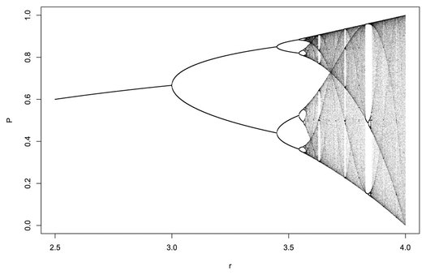
Logistic Map

Slide 22
The algorithm for encryption
Key generation:
We have 3 lists of secret keys: x₀, K_{r} and K_{c}.
The number of keys in K_{r} is the number of rows and the number of keys in K_{c} is the number of columns in the image.
Each key in K_{r} and K_{c} takes a random value between 0 and 255.
Decide the number of iterations of confusion and diffusion
The number of keys in x₀ is the number of iterations of confusion and diffusion
Each key in x₀ is calculated in the following way: Take 16 random 8 bit numbers, find their sum, divide by prime number 4091 and take the result modulo 1 to remove the integral part.

Slide 23
The algorithm for encryption
Encryption:
For each row i of image I:
Compute the sum of all elements in the row denoted by ai
Compute a_{i} modulo 2 denoted by Ma_{i}
If Ma_{i} = 0, right circular shift by K_{r}(i) positions, else left circular shift.
For each column j of image I:
Compute the sum of all elements in the row denoted by b_{i}
Compute b_{i} modulo 2 denoted by Mb_{i}
If Mb_{i} = 0, up circular shift by K_{c}(i) positions, else down circular shift.

Slide 24
The algorithm for encryption
3. Using vector K_{c}, the bitwise XOR operator is applied to each row of scrambled image I using the following expressions:
I(2i−1,j)=I(2i−1,j) ⊕ K_{C}(i),
I(2i,j)=I(2i,j) ⊕ rot180(K_{C}(i))
Where ⊕ and rot180(KC) represent the bitwise XOR operator and the flipping of vector KC from left to right, respectively.

Slide 25
The algorithm for encryption
4. Using vector K_{r}, the bitwise XOR operator is applied to each column of scrambled image I using the following formulas:
I(i,2j−1)=I(i,2j−1)⊕K_{r}(j),
I(i,2j)=I(i,2j)⊕rot180(K_{r}(j))

Slide 26
The algorithm for encryption
5. Calculate M x N values of the logistic map using X₀(i) as the initial value and Mu = 3.9999.
x_{n+1} = Mu*x_{n}*(1-x_{n})
6. x_{i} = int(x_{i}*10^16)%256, where int(x) represents the integral part of x
7. For each pixel p of the image I,
p_{i} = p_{i} ^ x_{i} if i = 0
p_{i} = (p_{i}+p_{i-1})%256^x_{i}, otherwise
8. Repeat steps 1 to 7 the number of iterations times

Slide 27
Security Analysis
Differential Attacks
Histogram Analysis
Correlation coefficient
Key Sensitivity
Key space analysis

Slide 28
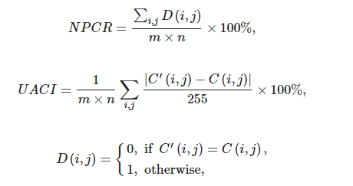
Differential Analysis
NPCR = Number of Pixels Changed Rate
UACI = Uniform Average Changing Intensity

Slide 29
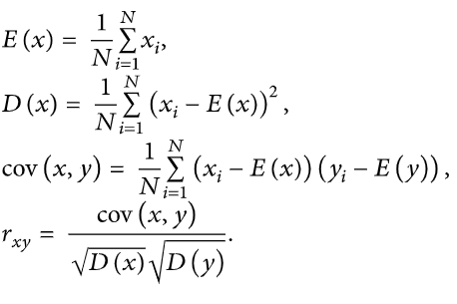
Correlation Coefficient

Slide 30
Applications Of Visual Cryptography
i). Biometric Authentication
ii). Digital Image Copyright Protection

Slide 31
Biometric Authentication
Enrollment Mode
Biometric Data is collected and encrypted using standard cryptographic algorithms(optional but highly recommended)
Encrypted image is converted into N secret shares, using VC scheme out of which at least K will be required for decryption.
Encrypted data will be sent to different database, and original data is discarded.
Authentication Mode
Service Application request databases to send relevant data required for decryption.
Received data is decrypted Using VC scheme and the compiled image is again decrypted to obtain the original image.
Recreated biometric image is matched with the user input and further decision is made.

Slide 32
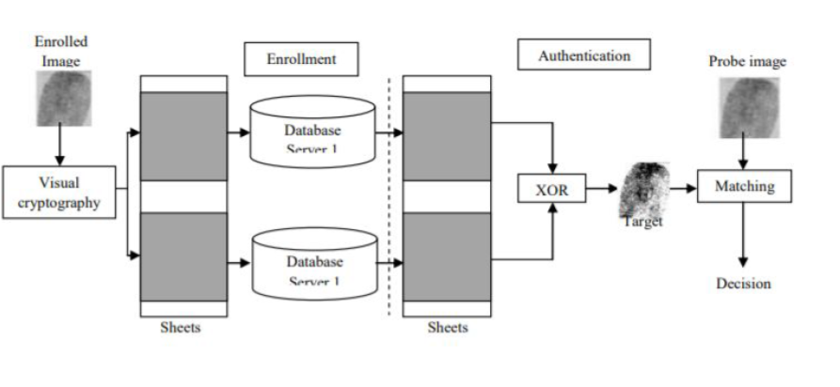

Slide 33

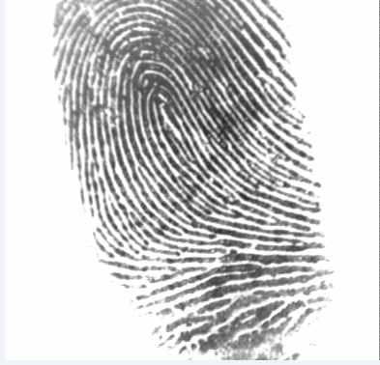
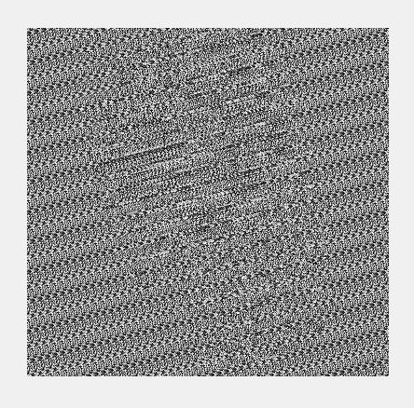
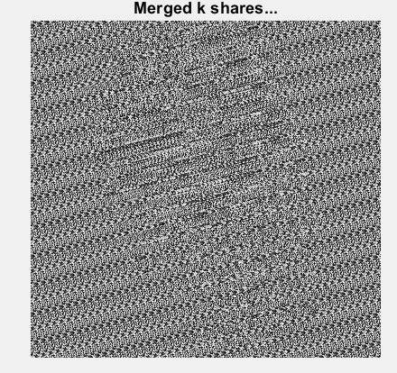
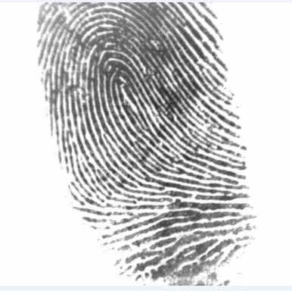


(K,N) Secret Share Encryption and Decryption Result K=2, N=3
1st Share
Original Image
Encrypted Image using Key
2nd Share
Final decrypted Image
Merged K Shares
3rd Share

Slide 34
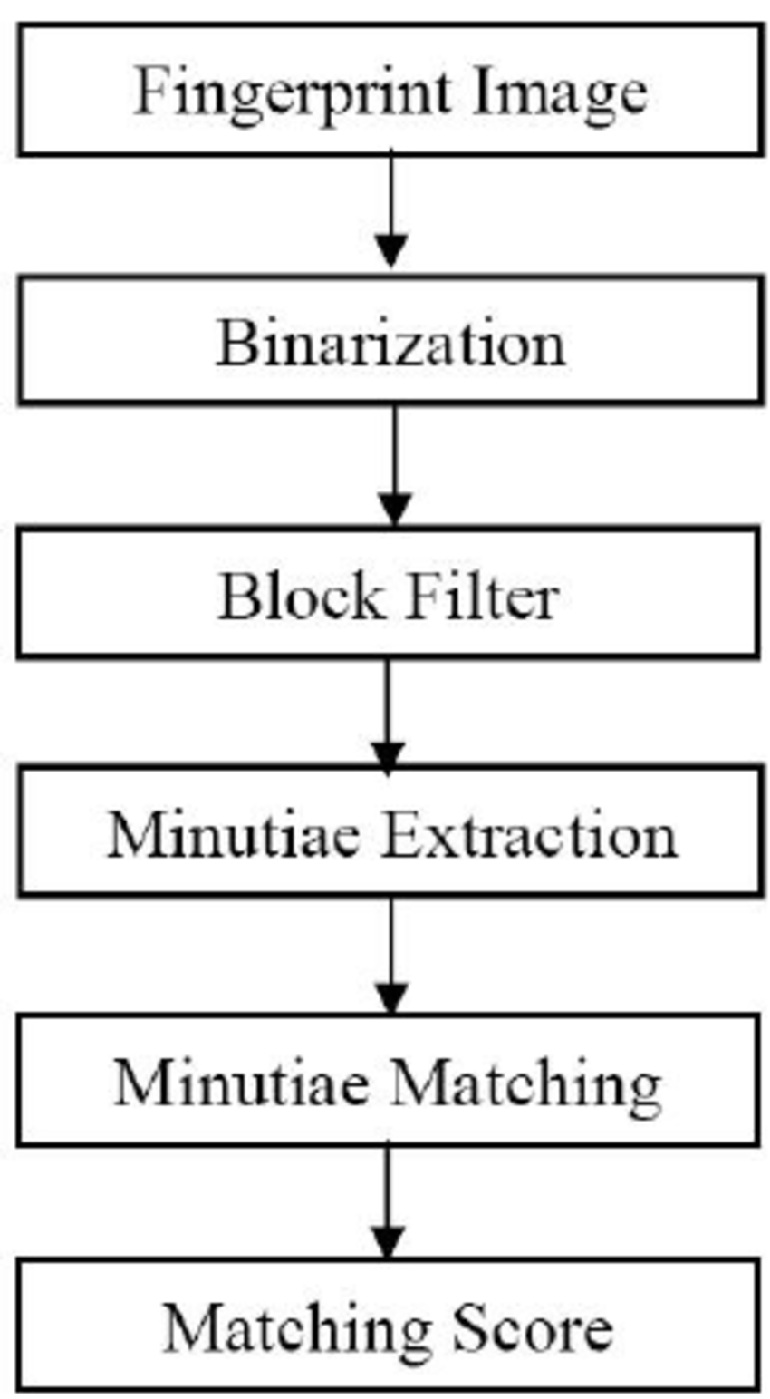
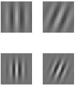
Flowchart for Fingerprint Recognition
Binarization - The grayscale image is converted into Binary image (0,1), by applying some threshold parameter.
Block Filter- matrix of w*w pixels. Used for feature Extraction
Ex-Median Filter, gabor filter

Slide 35
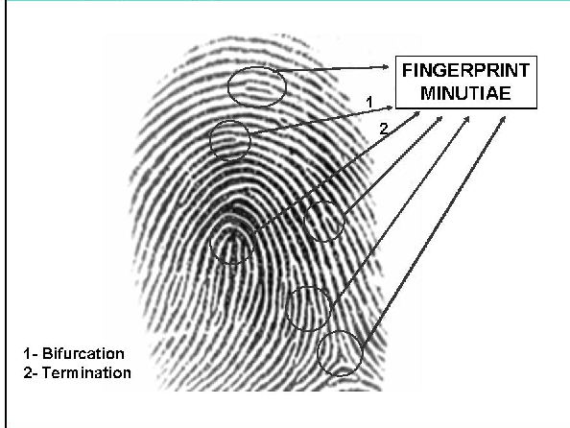
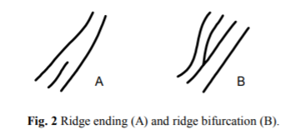
Flowchart for Fingerprint Recognition
Minutiae Extraction- Minutiae are the ridge bifurcation or a ridge ending on a fingerprint.
Ridge Filters and Bifurcation Filters are used.
Minutiae are extracted and matched with the source.

Slide 36
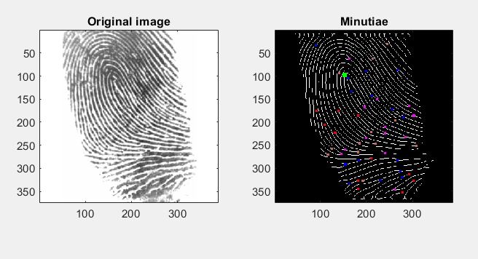
Minutiae Detection

Slide 37
Why use VC for Biometric Verification
Biometric templates are stored in the centralized database. Attack on one database can leak all the data.
With VC multiple shares of data are created, so attack on one database reveal no information.

Slide 38
Observations for Biometric Authentication
In (k,n) secret sharing Encryption and Decryption
When Kd<Ke , noise was observed in the image. (kd=K used at time of decryption , Ke=K specified at time of encryption)
As Ke-Kd increases, the noise in the decrypted image also increases.
Fingerprint recognition was accurate when the difference between Ke-Kd was small. (i.e. in range of [0,2])
In Fingerprint Recognition
The correct fingerprint had accuracy greater than .5, was observed in almost all of the cases.
The incorrect fingerprints in the dataset had accuracy in range of 0.2 -.35.
When the correct fingerprint was not detected, it was either due to less intensity of image or fingerprint area was lesser than the original image.

Slide 39
Digital image copyright protection
Reasons to use copyright protection schemes:-
Ownership assertion and copyright protection:- owner should have a way to embed or attach some information to the content so as to establish ownership and to be able to resolve disputes, if necessary.
Fingerprinting:- To avoid unauthorised duplication and sharing of content owned by a private entity which is available publicly, an invisible can be attached with the content.
Hidden information:- Some situations demand to embed hidden information like meta-data within the content itself.
Authentication and integrity:- Legal documents need to be verified if they were tampered or falsified. Digital signatures can be used for this purpose along with the current technology.
Parties involved in this scheme:-
Content creators
Content users
Content providers
Graphic software vendors
Attackers
Manufacturer of equipment

Slide 40
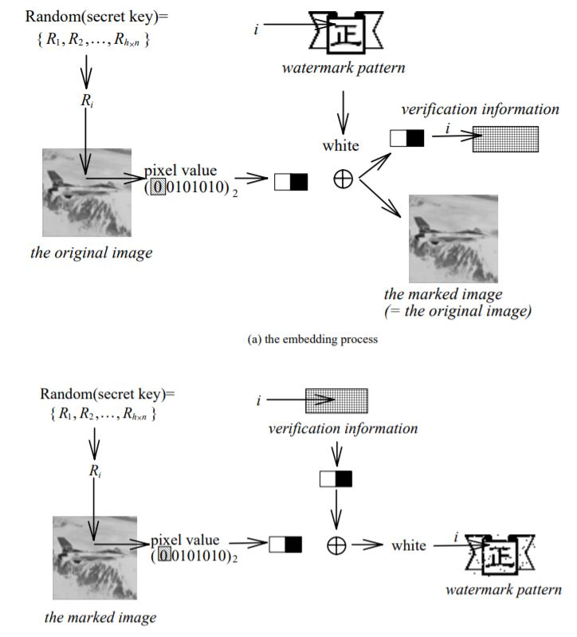



Digital image copyright protection
“Good artists imitate, great artists steal” ~ Picasso.
Original Image Watermark
Watermarked Image

Slide 41
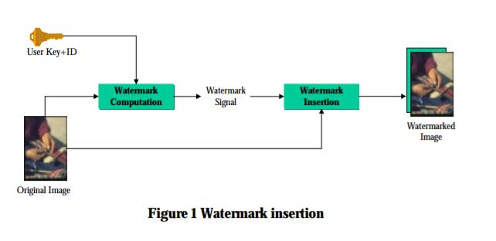
Insertion of watermark
For simplicity we assume watermark to be an image itself which is a function of parameters like user’s identity, user’s private key, etc. The watermark insertion step combines the watermark with the original image using pixel-by-pixel sum for the simplest case. Depending on the use and type of watermark other combining techniques can be used.

Slide 42
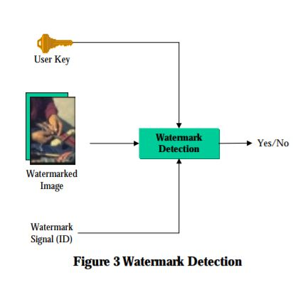
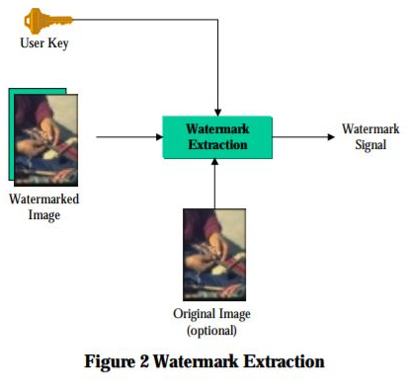
Extraction and Detection
The extraction algorithm requires a user key to separate the watermark from the image. Watermark detection also requires that the ID be presented at times. ID can also be one of the parameters while embedding the watermark. This algorithm checks whether there is enough correlation between the input ID and image, returning a value of yes/no depending on the threshold set.
Watermarking techniques like this require a user key which are classified as public or private key. For this a secure transmission channel is also needed for the exchange of keys.

Slide 43
Known Limitations and vulnerability
Watermarking technique is not quite old and it’s commercial use started just some years back. Since this is not mature technology, the required infrastructure and protocols are almost non-existent.
Watermark robustness can be attacked both technically and non-technically.
These attacks include:
Robustness attack
Analytic attack
Presentation attack
Interpretation attack

Slide 44
Differences between VC and Non-VC
Non-Visual Cryptography
Used for secure communication between two parties
Specific Decryption Algorithms are used for obtaining the final image.
The size of the File remains same.
Usability is Universal (i.e Can be used for any kind of file/data)
Visual Cryptography
Used for secure storage of data and verification. Can also be used to increase security of Non-Visual cryptography schemes
Decryption can be done by human eye by overlaying the shares.
The file size is expanded multiple times, depending on the value of N and the scheme.
Can be only used for raster files

Slide 45
Thanks!!!
Queries?

